Slide 1
Time and Space complexity

Slide 2
Time and Space complexity
In computer science, the time complexity is the computational complexity that describes the amount of time it takes to run an algorithm.
Space complexity is the amount of memory used by the algorithm (including the input values to the algorithm) to execute and produce the result.

Slide 3
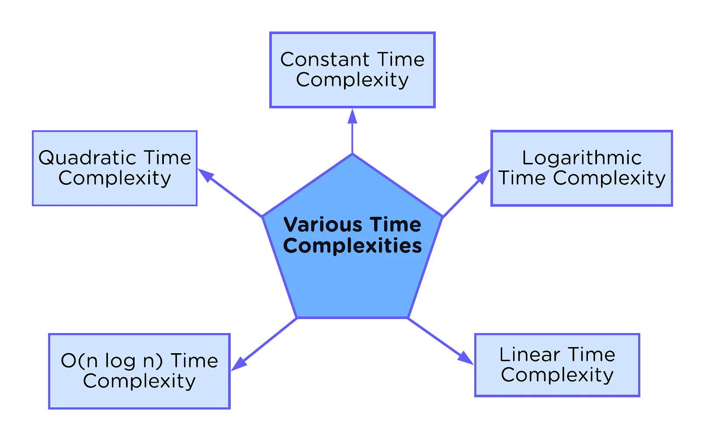
Comp 122

Slide 4
Asymptotic Notation

Slide 5

O-notation
Set of all functions whose rate of growth is the same as or lower than that of g(n).
g(n) is an asymptotic upper bound for f(n).

Slide 6

Ω -notation
Set of all functions whose rate of growth is the same as or higher than that of g(n).
g(n) is an asymptotic lower bound for f(n).

Slide 7

Θ-notation
For function g(n), we define Θ(g(n)), big-Theta of n, as the set:
Θ(g(n)) = {f(n) :
∃ positive constants c₁, c₂, and n_{0,} such that ∀n ≥ n₀,
we have 0 ≤ c₁g(n) ≤ f(n) ≤ c₂g(n)
}
Set of all functions that
have the same rate of growth as g(n).
g(n) is an asymptotically tight bound for f(n).

Slide 8
Write an algorithm to find the factorial of a number and also find its time complexity.

Slide 9







Comp 122

Slide 10







Comp 122

Slide 11
Common asymptotic growth functions (complexity classes) in an ascending order:
1 | - constant
log n | - logarithmic
n | - linear
n log n | - n log n
n² | - quadratic
n³ | - cubic

Slide 12
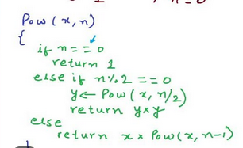
Comp 122

Slide 13
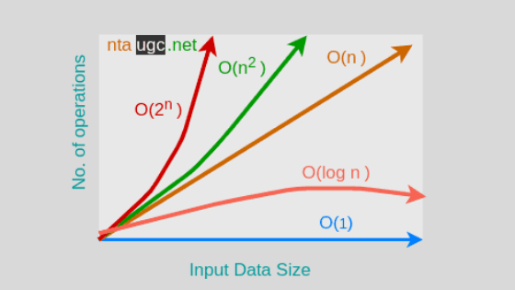
Comp 122

Slide 14
Code #1
sum = 0
for a in range (n) :
for b in range (n) :
for c in range (n) :
sum += a * b * c;
return sum;

Slide 15
Code #2
n1 = 0
n2 = 1
count = 0
while count < n:
print(n1, end=' , ')
nth = n1 + n2
n1 = n2
n2 = nth
count += 1

